Slide 1
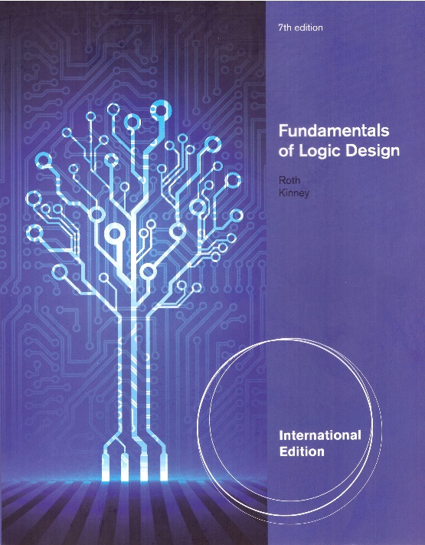
Unit 8
Combinational Circuit Design and Simulation Using Gate
This chapter in the book includes:
Objectives
Study Guide
8.1 Review of Combinational Circuit Design
8.2 Design of Circuits with Limited Gate Fan-in
8.3 Gate delays and Timing Diagrams
8.4 Hazards in Combinational Logic
8.5 Simulation and Testing of Logic Circuits

Slide 2
Objectives
Topics introduced in this chapter :
Draw a timing diagram for a combinational circuit with gate delays
Define static 0-and 1-hazards and dynamic hazard
Given a combinational circuit, find all of the static 0-and 1-hazards. For each hazard,specify the order in which the gate outputs must switch in order for the hazard to actually produce a false output
Given switching function, realize it using a two-level circuit which is free of static and dynamic hazards (for single input variable changes)
Design a multiple-output NAND or NOR circuit using gates with limited fan-in.
Explain the operation of a logic simulator that uses four-valued logic
Test and debug a logic circuit design using a simulator

Slide 3
8.1 Review of Combinational Circuit Design
Circuit Design Steps
Step 1: set up a truth table which specifies the output(s) as a function of the input variables
Step 2: derive simplified algebraic expressions for the output functions using Karnaugh maps, the Quine-McCluskey method
Step 3: realize the proper gate circuit
Step 4: realize minimum two-level AND-OR, NAND-NAND, OR-NAND, and NOR-OR (OR-AND, NOR-NOR, AND-NOR, and NAND-AND) circuits using the minimum sum of products

Slide 4
8.1 Review of Combinational Circuit Design
Circuit Design Steps
Step 5: Design the multi-level, multiple-output NAND-gate circuits by first designing a circuit of AND and OR gates (the minimum SOP)
Step 5e: Design of multi-level, multiple-output NOR-gate circuits is most easily accomplished by first designing a circuit of AND and OR gates.
In this case, the minimum sum-of-products expressions for the complements of the output functions is found.
Why NAND/NOR?
Money!!!

Slide 5
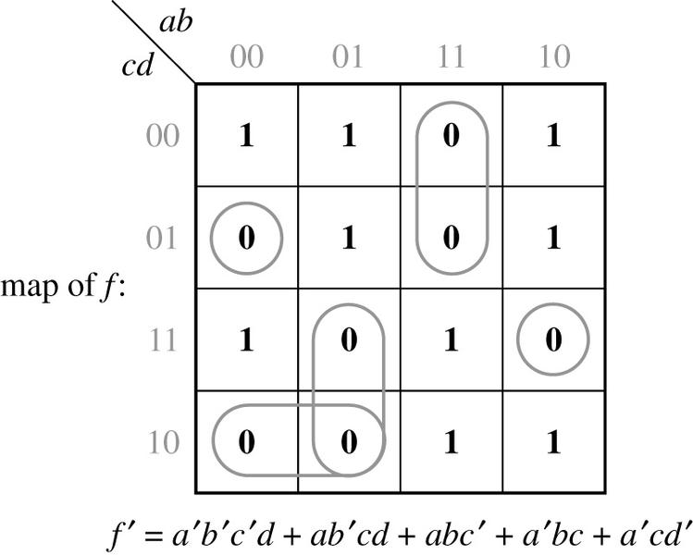
8.2 Design of Circuits with Limited Gate Fan-in
Example:
Realize f(a,b,c,d) = Σ m(0,3,4,5,8,9,10,14,15) using 3-input NOR gate
max

Slide 6
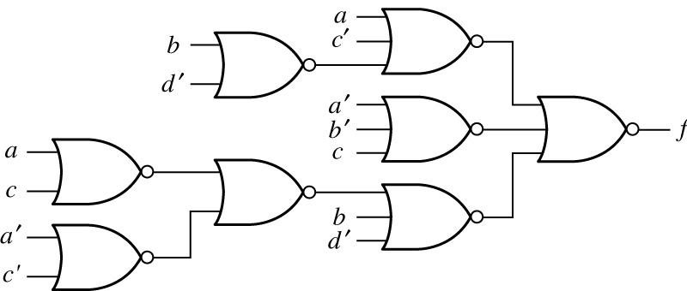
8.2 Design of Circuits with Limited Gate Fan-in

Slide 7
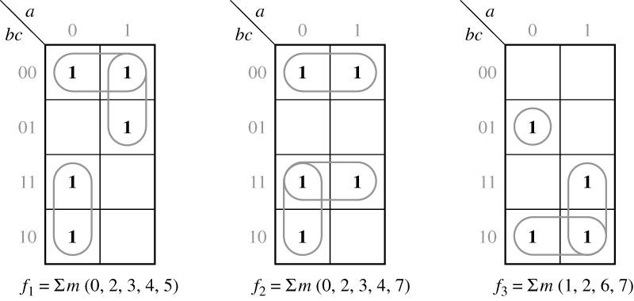
8.2 Design of Circuits with Limited Gate Fan-in
Example: Realize the functions given in Figure 8-2,
using only 2-input NAND gates and inverters.
If we minimize each function separately,the result is
Figure 8-2

Slide 8
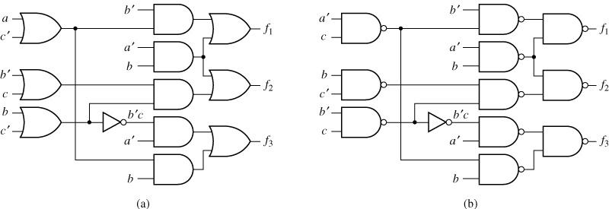
8.2 Design of Circuits with Limited Gate Fan-in
Figure 8-3: Realization of Figure 8-2

Slide 9
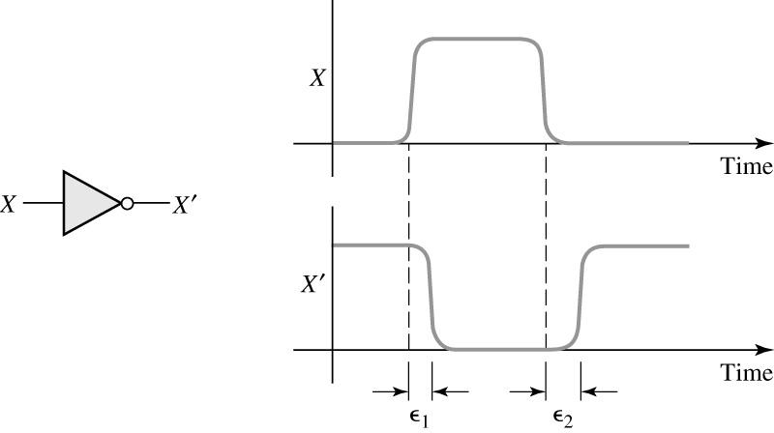
8.3 Gate Delays and Timing Diagrams
Propagation Delay in an Inverter

Slide 10
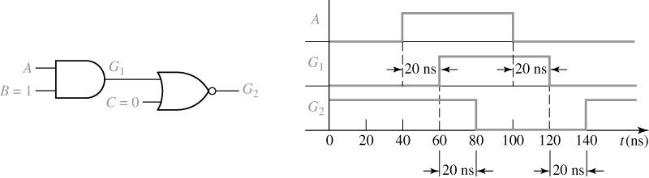
8.3 Gate Delays and Timing Diagrams
Timing Diagram for AND-NOR Circuit

Slide 11
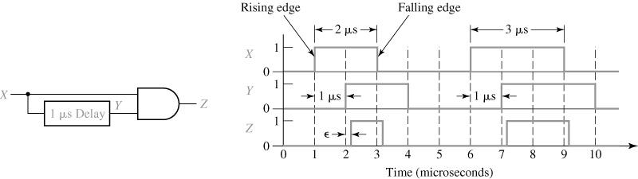
8.3 Gate Delays and Timing Diagrams
Timing Diagram for Circuit with Delay
No propagation delay

Slide 12


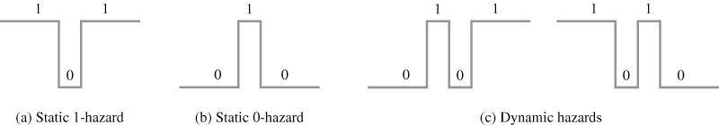
8.4 Hazards in Combinational Logic
Types of Hazards

Slide 13
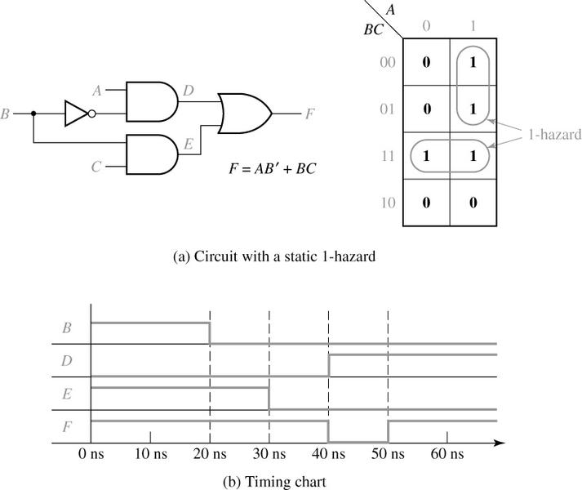
8.4 Hazards in Combinational Logic
Detection of a 1-Hazard
A = 1
C = 1
F = 1

Slide 14
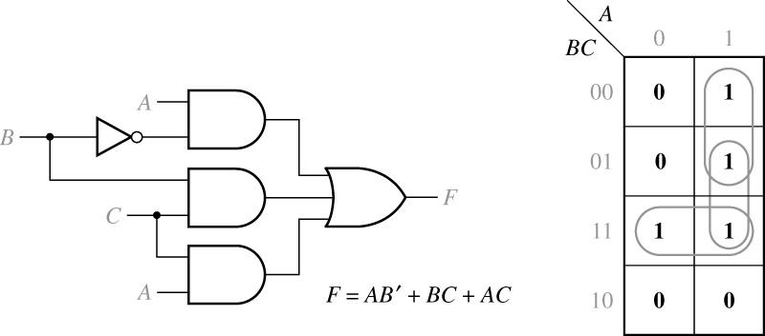
8.4 Hazards in Combinational Logic
Circuit with Hazard Removed

Slide 15
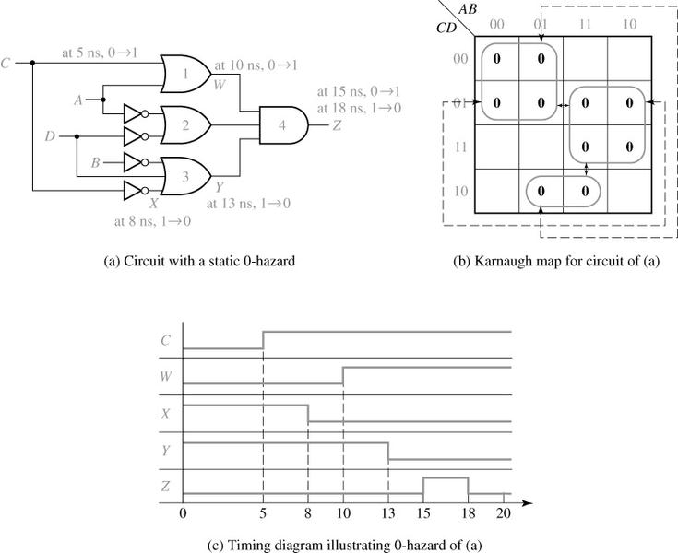
8.4 Hazards in Combinational Logic
Detection of a Static 0-Hazard

Slide 16
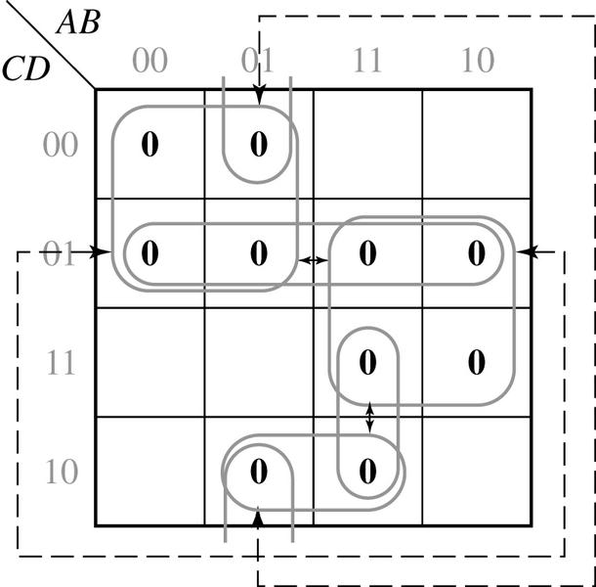
8.4 Hazards in Combinational Logic
Karnaugh Map Removing Hazards

Slide 17
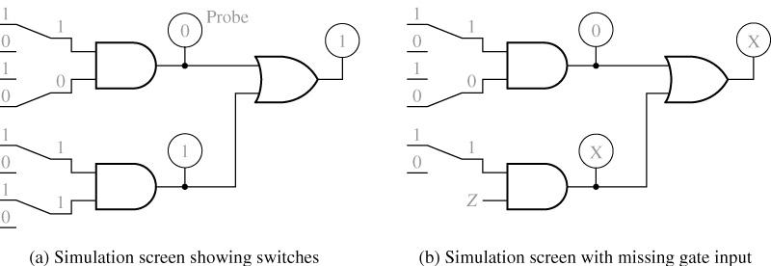
8.5 Simulation and Testing of Logic Circuit

Slide 18
8.5 Simulation and Testing of Logic Circuit
And and OR Functions for Four-Valued Simulation
x | 0 1 X Z
0 1 X Z | 0 0 0 0 0 1 X X 0 X X X 0 X X X
+ | 0 1 X Z
0 1 X Z | 0 1 X X 1 1 1 1 X 1 X X X 1 X X

Slide 19
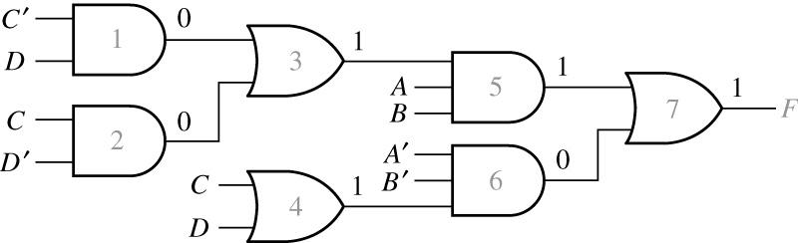
8.5 Simulation and Testing of Logic Circuit
Logic Circuit with Incorrect Output
Example:

